Slide 1
Bug Similarity in Heterogeneous Networks
SOE-Research Project
GROUP - Club_Elite
Instructor - Amit Kumar, Ashutosh Kumar
Harsh Goyal IIT2018114
Aaditya Gadhave IIT2018144
Sourabh Gupta IIT2018149
Meet Singh Gambhir IIT2018158
Tushar Atrey IIT2018159

Slide 2
ABSTRACT
In this research project we have devised an algorithm to predict the relationship (any kind of relationship) between any pair of given bugs. This algorithm takes input from all the previous relationships between the bugs and predicts the extent of any new relationship between any new pairs of bugs.

Slide 3
INTRODUCTION
MAIN AIM : In this project , We have consider two bugs which work on the same file then these two bugs are considered to be similar and there might be chances that they two have relation in future.
This is just one kind of relationship. This relationship is generally denoted in the form of metapath that means that if two bugs are similar they have a path that connects these two bugs via any type of relationship. There are a total of 22 different metapath between any two given bugs which are given in next slide.

Slide 4
B-T-B : Bug reports having the same term.
B-R-B : Bug reports reported by same reporter.
B-C-B : Bug reports found in the same components.
B-A-B : Bug reports assigned to the same assignee.
B-D-B : Bug reports assigned to the same developer.
B-F-B : Two bugs changing the same file.
B-T-B-D-B : If B1 and B2 are related by the same term and B2 and B3 are related by the same Developer then B1 and B3 are related by this type of relationship.

Slide 5
B-R-B-D-B : If B1 and B2 are related by the same reporter and B2 and B3 are related by the same Developer then B1 and B3 are related by this type of relationship.
B-C-B-D-B : If B1 and B2 are related by the same component and B2 and B3 are related by the same Developer then B1 and B3 are related by this type of relationship.
B-A-B-D-B : If B1 and B2 are related by the same assignee and B2 and B3 are related by the same Developer then B1 and B3 are related by this type of relationship.
B-F-D-F-B : Two bug reports which are committed by the same developer i.e if B1 changes file F1 and is committed by developer D and if another bug B2 changes file F2 and is committed by same developer D then B1 and B2 are connected by this path.
B-T-F-B : If bug report B1 has term T which is also found in some path of file F and F has been changed by B2 then B1 and B2 are related by this path.
B-C-F-B : If bug report B1 has component C which is also found in some path of file F and F has been changed by B2 then B1 and B2 are related by this path.

Slide 6
B-T-B-F-B : If B1 and B2 are related by the same term and B2 and B3 change the same file then B1 and B3 are related by this type of relationship.
B-R-B-F-B : If B1 and B2 are related by the same reporter and B2 and B3 change the same file then B1 and B3 are related by this type of relationship.
B-C-B-F-B : If B1 and B2 are related by the same component and B2 and B3 change the same file then B1 and B3 are related by this type of relationship.
B-A-B-F-B : If B1 and B2 are related by the same assignee and B2 and B3 change the same file then B1 and B3 are related by this type of relationship.
B-T-B-F-D-F-B : If B1 and B2 are related by the same term and B2 and B3 are changing the same file which are committed by the same developer then B1 and B3 are related by this path.
B-R-B-F-D-F-B : If B1 and B2 are related by the same reporter and B2 and B3 are changing the same file which are committed by the same developer then B1 and B3 are related by this path.

Slide 7
B-C-B-F-D-F-B : If B1 and B2 are related by the same component and B2 and B3 are changing the same file which are committed by the same developer then B1 and B3 are related by this path.
B-A-B-F-D-F-B : If B1 and B2 are related by the same assignee and B2 and B3 are changing the same file which are committed by the same developer then B1 and B3 are related by this path.
B-F-P-F-B : If B1 and B2 are changing the same file which are located in the same package then they are related by this path.

Slide 8
PRODUCT SCOPE
There are two types of graph. They are:
1) Heterogeneous graphs
2) Homogeneous graphs
Heterogeneous graphs are those which have different kinds of nodes and edges i.e they are of different types.
Homogeneous graphs are those which have the same (or similar) kind of nodes and edges.

Slide 9

HETEROGENOUS GRAPH
Heterogeneous graph is one of the latest concepts which has gained a lot of attention in recent times as due to the advantage of its over that of the homogenous one as it contributes very more of that in retrieving the information than the homogenous one.
The main reason for this being that it considers all types of possible elements of the network as nodes , and any edge between the two , ensures their connectivity , whether they being of different types of nodes , which is not being the case when we deal with the homogenous one. It will use that there will be some sort of similarities between two nodes based on the heterogeneous graph
It has various useful applications such as predicting relationships between various possibilities of two nodes possible and not only the two bugs only.

Slide 10
PROCEDURE
At first we started with the B-X-B kind of meta path and then with help of these we built algo for a bigger metapath. We used the test cases provided in the dataset by the instructor to run our algorithm. We used a database to store all the count of paths between every two bugs using algorithms similar to dfs (depth-first-search) and bfs (breadth-first-search).
We used Python Language for this project as it is easy to use and has many libraries which are helpful for this algorithm. With python we can also implement Machine Learning Algorithm that helps to predict the future relationships between the bugs with the help of present relations between the bugs. I.E. if we use a test case consisting of a certain kind of relationship between the bugs, called the training data then with the help of the algorithm if there is a certain path between the bugs then the algo predicts the future possible relationship between the bugs and their probability of success.These were called as Testing dataset.
After this the instructor asked to use the concept of lemmatization. Lemmatization is the process where given a text we convert all verb form into present form. For topic modelling we were introduced with various tool like Gensism, LDA++ and Mailet tool. It also helps to remove stop words (is, the, are,etc.) using Spacy Library.We then with the help of this developed an algorithm that took word n-gram from two different text files and compared these n-grams.

Slide 11
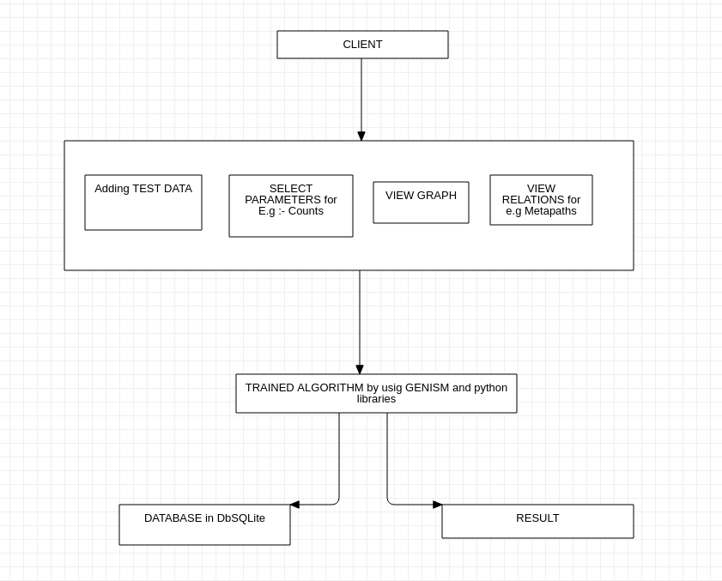
Conceptual Architecture/Architecture Diagram
Architecture Diagram 1:
The architecture diagram shows us how the software will interact with client and with the help of the algorithm trained by the software like Genism we can predict the count of metapath and the percentage of similarity between 2 bugs . The client will provide the test data for which we have to do these calculations . The algorithm needs to be need to be trained on some datasets so as it could make better and accurate predictions.

Slide 12
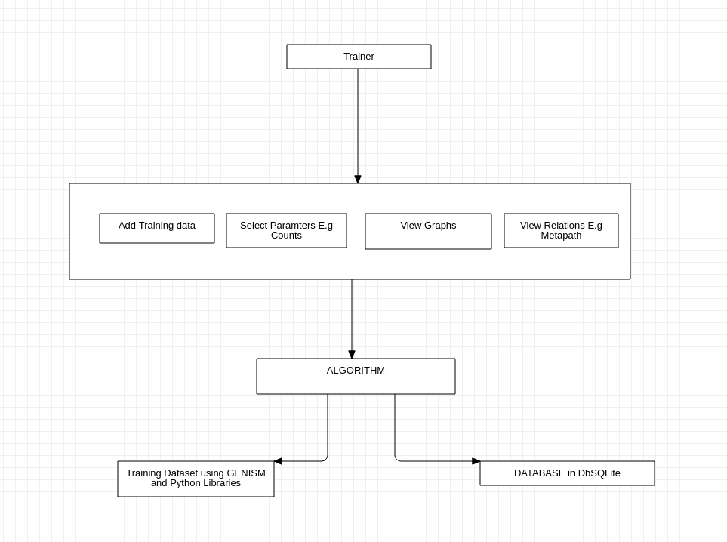
Architecture Diagram 2 :
The above architecture diagram depicts the training of algorithms. The trainer provides suitable Training data set for the algorithm to train itself and after an adequate amount of training we are ready to try it on the actual data set.

Slide 13
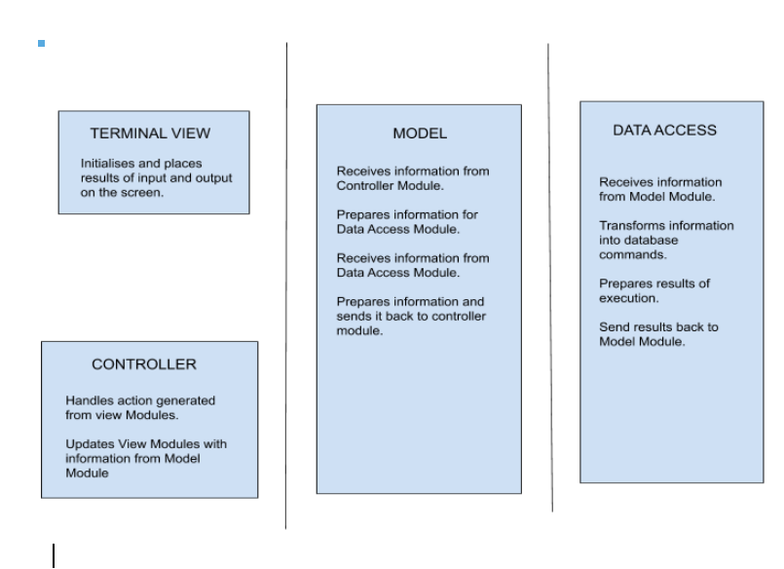
Overview of modules / Components
NOTE:
The horizontal lines represent the separation of modules.
More than one box within the same section represents sub-modules.

Slide 14
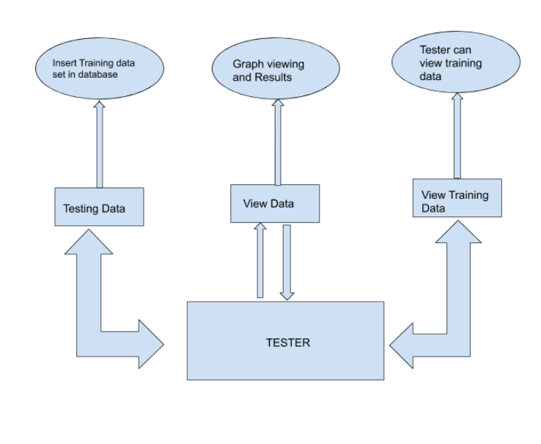
Structure and relationships
Tester’s Side
The diagram shows the structure and relationship of the tester with the software. Tester firstly inserts the training data to test and then he get back the results and the count of different metapath that exist and similarity between 2 bugs. Tester is the one which can see the training as well as testing data both whereas users can only see the testing data.

Slide 15
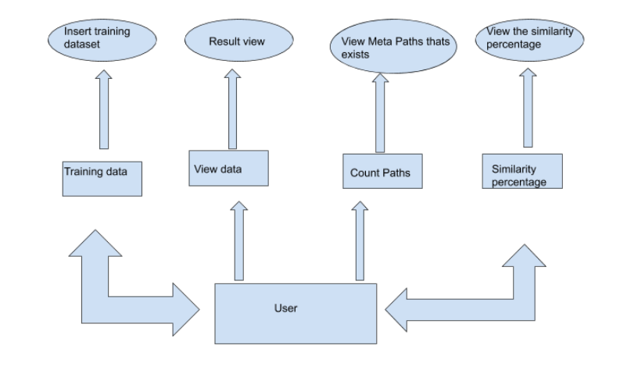
User’s Side:
The diagram shows the structure and relationship of user with the
software. User firstly inserts the training data and then he gets back the results for different types of meta paths between that exists (all possible) and counts the paths that exist. And then the calculation is done on the basis of relations that are similar between 2 bugs.

Slide 16
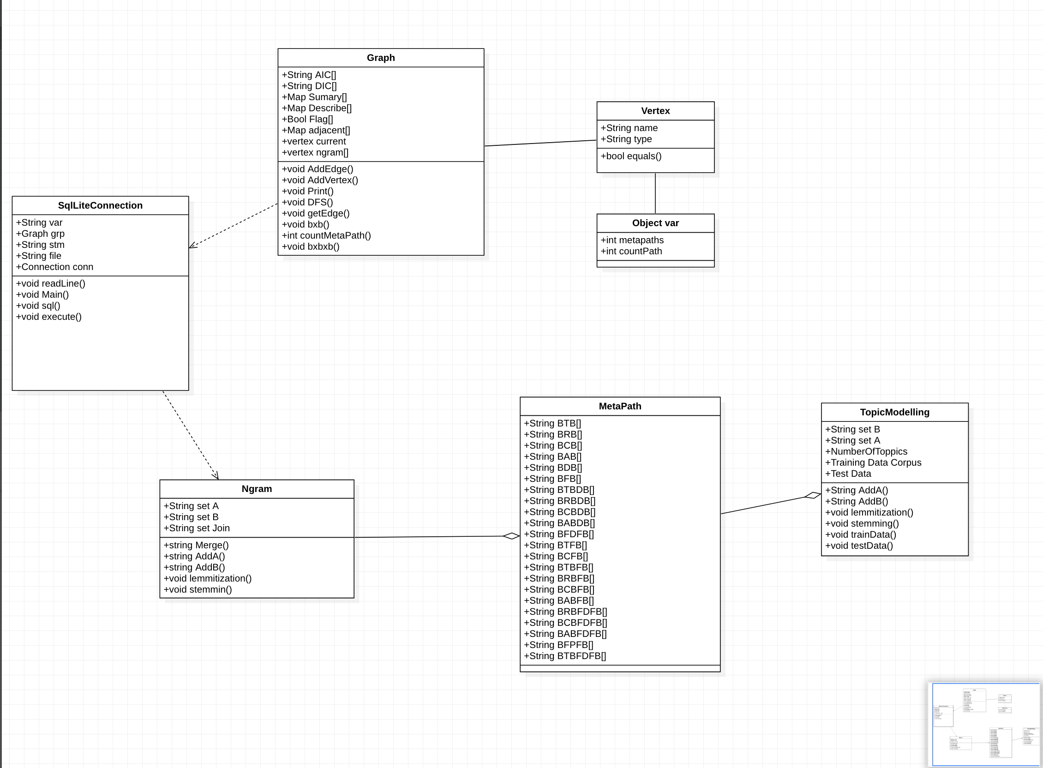
Logical Architecture
Class Diagram :

Slide 17
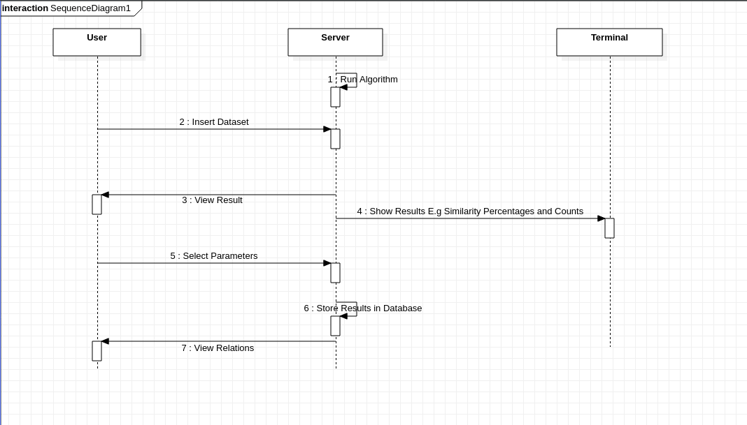
Sequence Diagrams:
The sequence diagram on the right side represents how our software is basically
going to work. The User/Client will provide the required dataset and as an output of trained algorithm will produce the required results based on the parameters selected by the user.
Basically, our sequence diagrams represent either how our software interacts with the user to produce the required results, how our algorithm was trained by the trainer so that algorithm could become capable of Predicting accurate similarity between 2 bugs and calculate the percentage of similar text based on topic, understanding by using n gram similarity.

Slide 18
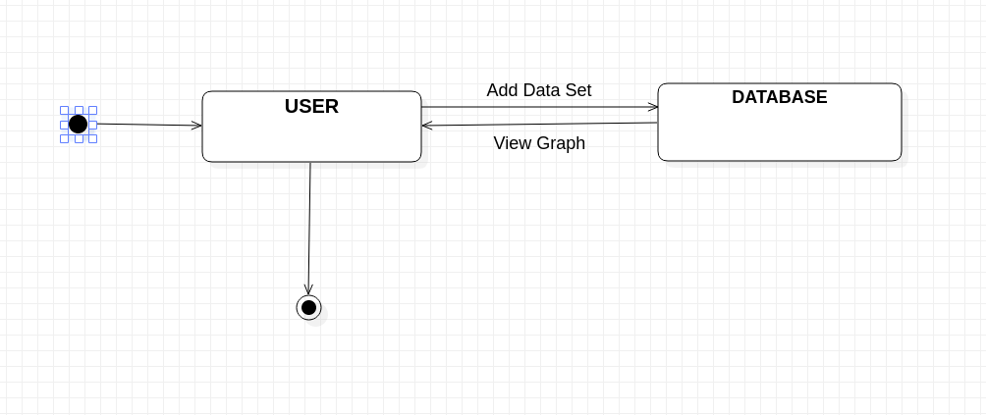
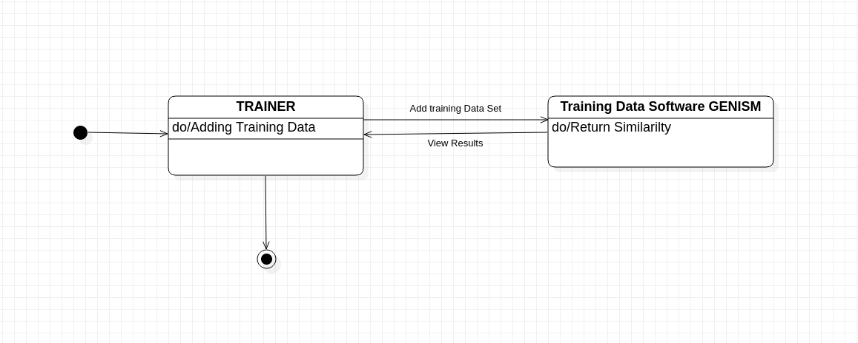
STATE DIAGRAMS
State diagrams are mainly used to capture the behaviour of software system. State machine diagrams can be used to model the behavior of a class, a subsystem, a package, or even an entire system. It is also called a Statechart or State Transition diagram.
State diagram 1: Admin inserts data
State diagram 2: Trainer inserts data

Slide 19
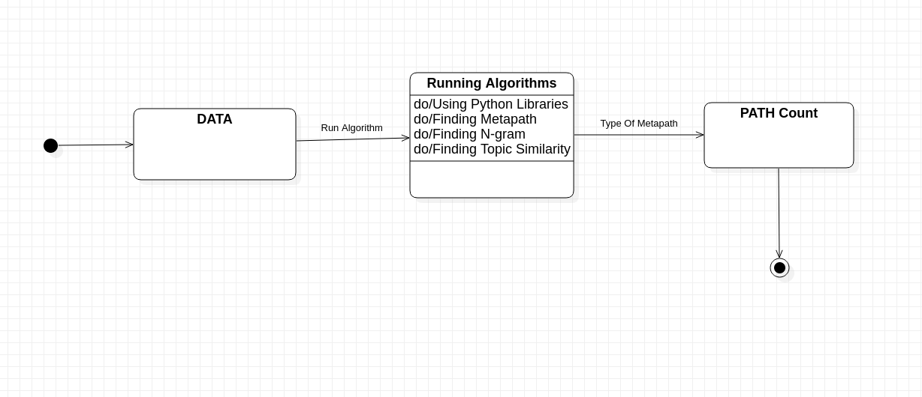
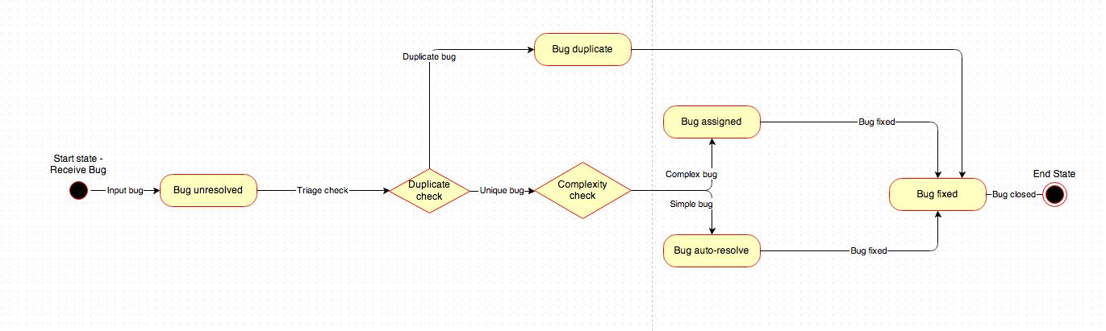
State diagram 3: Algorithm for path counts
State Diagram 4: Similarity between 2 bugs

Slide 20
Design decisions and tradeoffs
Since our Software involves the prediction of links between any specified entities thus it does not have any frontend involved with it all it includes is the prediction of accurate links. Thus, this software has a wide range of applications and can be put to use with many other products such as social media platforms, performance analyzers, etc.
The Design decision to use a Relational Database rather than a Non-Relational Database is basically to improve the scalability and also because we have a defined Schema in case of SQL databases.
The End-user for our software are basically other product-based applications that can use our software to improve their product and increase its functionality.

Slide 21
Use Case

Slide 22
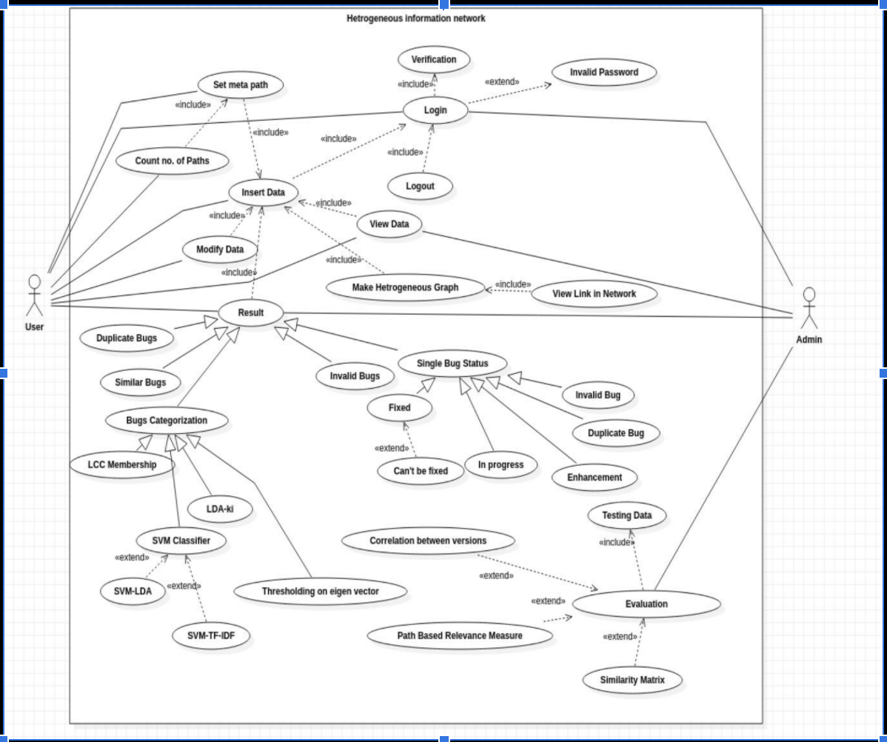

Slide 23
Functionality of Use Case
Name: Insert Data
Summary: Allows users to insert data about the bugs of the project.
Actors: User
Main success scenario:
• Admin provides a dataset in the form of a sqlite database.
• App connects the sqlite database with the project and includes it for predicting Bug Similarities.
Extension: Here we are working with sqlite databases for this project, but we can also work with other databases after performing database migrations such as MySQL.
Post-condition: Project will now use the given database for predicting Bug Similarities.
Name : Login
Summary : Allows admin/user to login .
Actors : Admin/User
Main success scenario :
• Admin/User clicks on the login button.
• App checks for the Verification of login.
Extension: Id or password incorrect. Shows error dialog box.
Post-condition-: Admin/User can now access all features of the app.

Slide 24
Name: View Data
Summary : Allows admin/user to view the SQL database to our application
Actors :Admin/User
Main success scenario:
• Actor connects to the database successfully and verifies the data.
Post-condition: Admin can now access the data from different projects in our heterogeneous graph.
Name: Modify Data.
Summary: User can modify the existing database.
Actors: User
Main Success Scenario:
• Users cross-verifies the database and make required changes.
Post Condition: Now User can expect Correct Result.

Slide 25
Name: Make Heterogeneous Graph. Summary: From the given database Admin creates the required Heterogeneous Graph.
Actors: Admin
Main Success Scenario:
• Successful formation and display of the required graph.
Extension: Now the link between the nodes can be viewed in the network.
Post Condition: Now we can Predict the similarity between bugs by using this graph.
Name: Number of the paths for metapath.
Summary: Calculate total number of paths with the given type of metapaths Actors: Admin
Main Success Scenario:
• There are various types of meta paths in the dataset and calculation of total number of paths of the specified metapath between bugs.
Post Condition: Prediction of similarity between bugs by counting total number of paths of all the meta paths.

Slide 26
Name: Choose meta paths.
Summary: Admin gives different types of meta paths to find the links between Bugs.
Actors: User
Main success scenario:
• Admin provides various metapaths which will be studied as a criteria for prediction of Bug similarity.
• App measures the number of various metapaths to use a path based relevance measure algorithm.
Post-condition: Project will now measure all the various kinds of metapaths, so that path based relevance measure algorithms can be applied.
Name: Result.
Summary: From the given database Admin concludes the outcome from Heterogeneous Graph
Actors: User
Post Condition: Now the User can see the details of the result.

Slide 27
Name: Duplicate Bugs.
Summary: From the result user can view all the duplicate bugs of the data.
Actors: User
Main success scenario:
• App measures all the Duplicate Bugs and shows it to the user.
Post-condition: All the Duplicate Bugs can be discarded.
Name: Similar Bugs.
Summary: From the result the user can view all the Similar bugs of the data.
Actors: User
Main success scenario:
• App measures all the Similar Bugs and shows it to the user.
Post-condition: All the Similar Bugs can be categorised into one category.

Slide 28
Name: Invalid Bugs.
Summary: From the result the user can view all the Invalid bugs of the data. Actors: User
Main success scenario:
• App measures all the Invalid Bugs and shows it to the user.
Post-condition: All the Invalid Bugs will be discarded and not considered into the data.
Name: Single Bug Status
Summary: From the result the user can view the status of any particular bug. Actors: User
Main success scenario:
• App measures all the Status of the particular chosen bug and shows it to the user.
Extension: A particular bug can be fixed , or in progress , is invalid or can be among the duplicate ones or even can be an enhancement.

Slide 29
Name: Bug Categorisation.
Summary: From the result the user can view all the classification of the bugs of the data.
Actors: User
Main success scenario:
• App measures all the classification of the Bugs and shows it to the user.
Extension: Different algorithms such as LCC membership , SVM classifier , LDA-Ki , Thresholding on eigenvectors are employed to categorise the bug
Post-condition: All the similar Bugs will be categorised in the same category.
Name: Path based Relevance Measure
Summary: Finding the relatedness of an object pair depending on the given relevance path.
Actors: Admin Software Requirements
Main success scenario:
• Admin calculates the relatedness of bugs connected in the heterogeneous graph using the Path based Relevance measure algorithm given in HeteSim: A General Framework for Relevance Measure in Heterogeneous Networks.
Post-condition: Project will provide correlation between users(Developers) in a range from 0 to 1, using a path based relevance measure algorithm.

Slide 30
Name: Testing data.
Summary: A dataset is added to our application for testing of our algorithm and checking its correctness.
Actors: Admin
Name: Evaluation
Summary: Calculates accuracy between predicted links using different projects
Actors: Admin
Main success scenario:
•Based on previous predictions we can calculate our accuracy percent by calculating the pearson coefficient.
Post-condition: We can know the accuracy of predicting a new link.
Name: Design similarity matrix
Summary:Similarity Matrix is created by the training data which will further help in generating links.
Actors: Admin
Main success scenario:
• The similarity matrix between different types of nodes is created and it helps in link prediction techniques using this matrix.
Post-condition: Now the application contains a similarity matrix which can be further used for link prediction in our heterogeneous graph .

Slide 31
Name: Correlation between different versions of a project.
Summary: Prediction of similarity between bugs in different versions of the project.
Actors: Admin
Main success scenario:
• The project checks newer versions of any given project to check if the link predicted by the app does actually exist in the future.
Post-condition: This will help to research to what extent does heterogeneous graph predicting links works.
Name: Training data
Actor : Admin
Main success scenario:
•.Training data is quite essential for generating appropriate results from the algorithm.
• A separate graph is created based on the training dataset in which we can test our algorithm to increase the accuracy of our algorithm.
Extension: The given dataset should be valid i.e it should contain all the required fields for our algorithm to work else an error message will be shown.
Post-condition: The algorithm is now trained and can be seen working correctly if not the necessary changes can be made so that it works fine on big datasets.

Slide 32
THE TRAVERSAL AND COUNTING OF THE PATHS
The graph constitutes , of each possible element of the project (viz Bug,term , component , file , Developer) as a vertex in the graph , and any two of the vertices , being related , by a relation (say a bug , changing contents of a particular file) ,are related , and this constitutes as an edge in our graph.
There are different types of vertices , in the graph , any thus , many different types of edge, i.e. relating any two types of vertex.Now this makes the graph heterogeneous in nature.
As the graph is not homogenous , the concepts now should be somewhat modified , in order to apply to the heterogenous one, comprising considering different types of vertices and edges differently among themselves, which is sufficient in order to do operations for the heterogeneous one.
Now from each vertex as the starting one, each type of already mentioned path’s frequency is needed to be calculated .The algorithm used to do so is dfs, i.e. the depth first traversal.

Slide 33
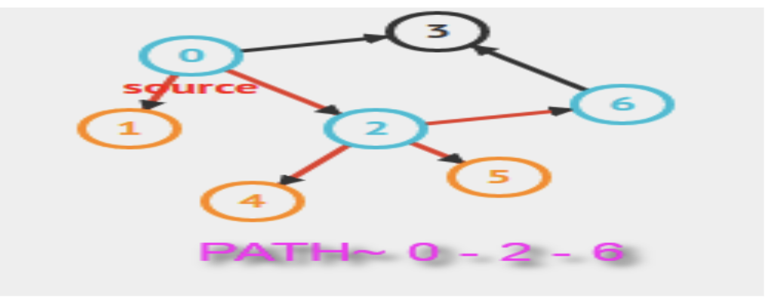
Why DFS?
Just like an iteration in an array ,to traverse the array , there are two possibilities to do in case of graphs, dfs and bfs.
The dfs algorithm begins at a starting node, and proceeds to all other nodes that are reachable from the starting node using the edges of the graph.Depth-first search always follows a single path in the graph as long as it finds new nodes. After this, it returns to previous nodes and begins to explore other parts of the graph. The algorithm keeps track of visited nodes, so that it processes each node only once. Whereas Bfs visits the nodes in increasing order of their distance from the starting node.

Slide 34
Breadth-first search goes through the nodes one level after another. First the search explores the nodes whose distance from the starting node is 1, then the nodes whose distance is 2, and so on. This process continues until all nodes have been visited.
The time complexity for both the algorithms is the same , each being O(n+m) , n being no. of nodes and m , being the no. of edges . because each edge will only be traversed, twice , one time from each of the two connecting vertices, for each algorithm(bfs or dfs whichever you are proceeding) .So the time factor is nullified from sides.
Coming to the reason that we are opting for dfs , is that we want to store the path from the initial source , to each vertex ,so as to check which type of path is this from the source , and in each iteration in the dfs algorithm , the path is changed by at most 1 value.

Slide 35
The steps in dfs are:
a.) Picking a starting node and pushing all its adjacent nodes using edges from it , into a stack.
(This will add the starting node in the path 1 iteration and the path from the starting to this vertes , is the current content in the path).
b.) Pop a node from stack to select the next node to visit ( popping from top a node , from the stack is a one iteration process ) and push all its adjacent nodes into a stack (this step will not change the path).
While in case of obtaining the path (i.e. the order of vertices visited from the source vertex ,, to reach any vertex ) , we will need additional O(n) , time , which will make it worse than dfs.

Slide 36
FUNCTIONS ON META PATH
Path count.
Path count means the same as the word suggests.When following a particular meta path, the no. of instances found between any two vertices of the graph, is stored as path count, denoted as PCR(ai,aj),
where R is the relation between the two vertices of the meta path which relates the two vertices. Path count is the product of adjacency matrices associated with each relation in the meta path.
Normalized path count.
No. of paths in the overall connectivity for the two vertices in the graph, is the
normalised path count, and is defined as:
NPCR(ai , aj ) = PCR(ai,aj )+PCR~ (aj ,ai) PCR(ai,·)+PCR(·,aj ) , where
R~ denotes the inverse relation of R,
PCR(ai , ·) is the total number of paths following relation R starting with ai .i.e. Covering all the possibilities for the end vertex. , and
PCR(·, aj ) is the total number of paths following relation R ending with aj i.e. covering all the possibilities for the starting vertex..

Slide 37
Random walk.
Random walk for a particular path is ->
RWR(ai , aj ) = PCR(ai,aj ) PCR(ai,·) ,where PCR is the same as Path count , following the relation R.
Symmetric random walk.
Symmetric random walk considers both way random walk along the meta path->
SRWR(ai , aj ) = RWR(ai , aj ) + RWR~ (aj , ai).

Slide 38
Using Topic Modelling ToolKit in Python (Gensim)
Install the requirements using pip3 install -r requirements.txt.
First we will do lemmatization and stemming of training and test data using Spacy.
Select the train data ( summary + description of Bug) and give it as input (insert into the corpse ) to the Program.
Now Select the test data and number of topics
Run the Program you will get the first k mentioned topics from trained data (corpse).

Slide 39
Sample Data and Result

Slide 40
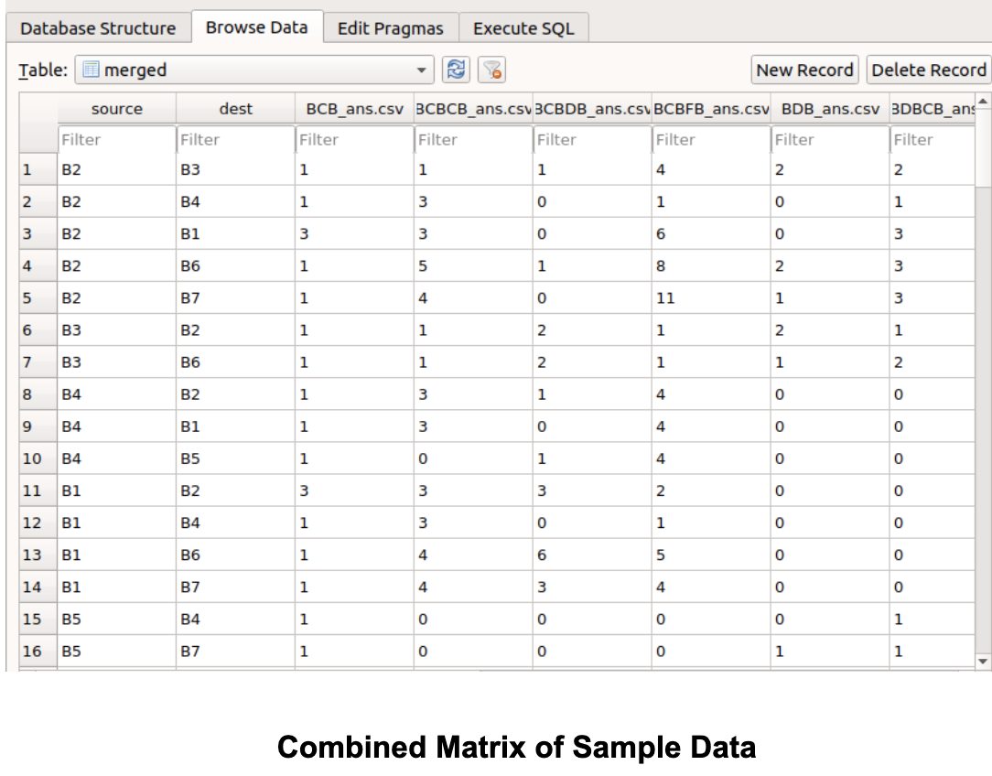

Slide 41
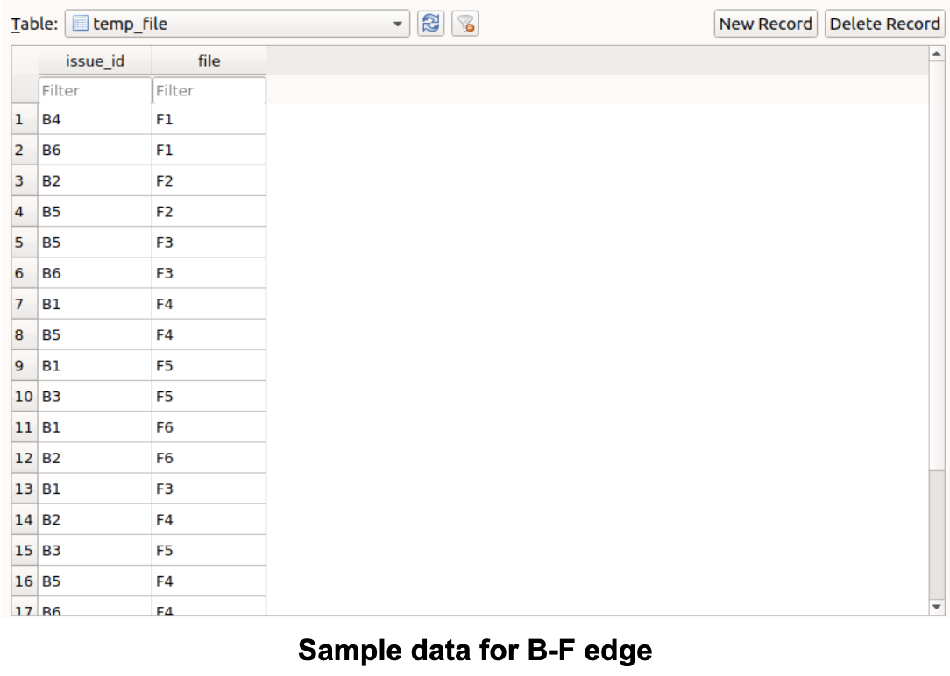

Slide 42
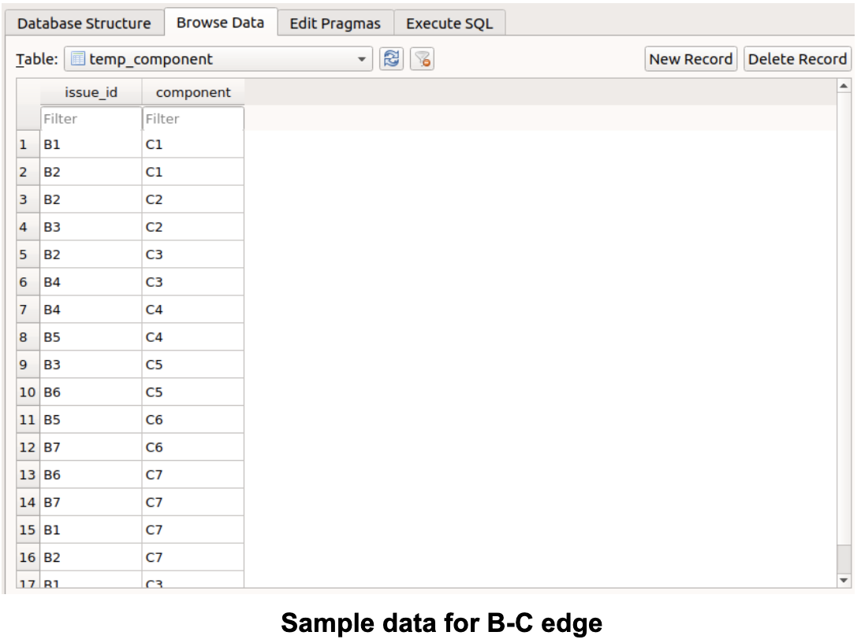

Slide 43
